Slide 1
Usability Evaluation

Slide 2
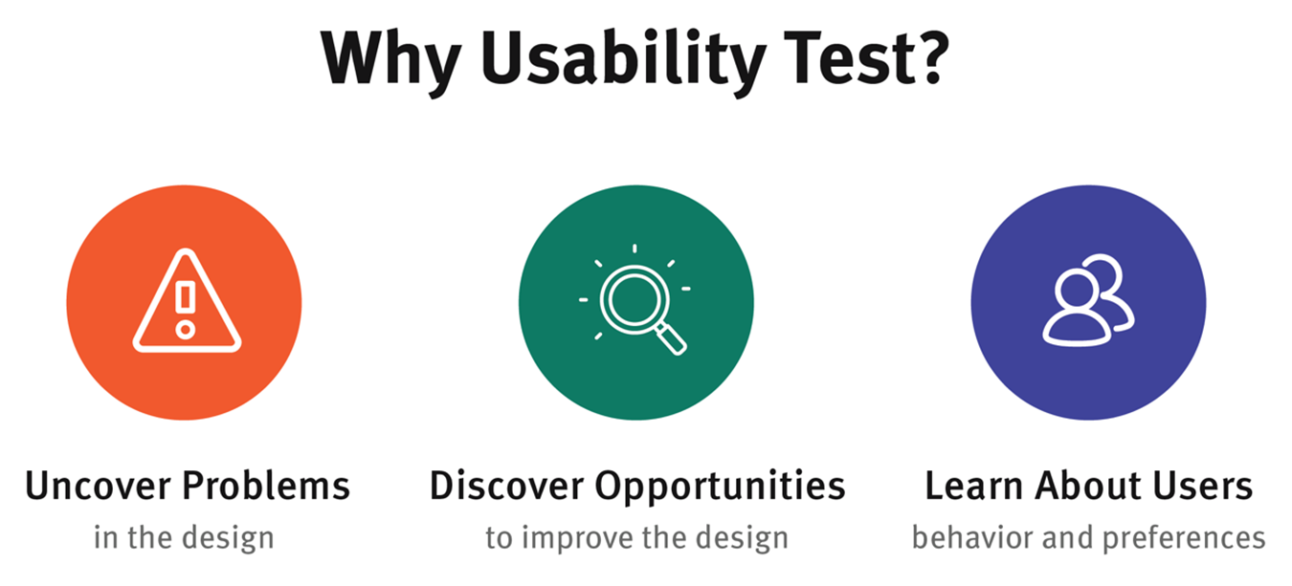
Usability Evaluation
Focuses on how well users can learn and use a product to achieve their goals. It also refers to how satisfied users are with that process.
The goals of usability testing usually include:
Notes:
The goals of usability testing usually include:
Identifying problems in the design of the product or service
Uncovering opportunities to improve the design
Learning about the target user’s behavior and preferences

Slide 3
Usability’s 5 quality components
Learnability: How easy is it for users to accomplish basic tasks the first time they encounter the design?
Efficiency: Once users have learned the design, how quickly can they perform tasks?
Memorability: When users return to the design after a period of not using it, how easily can they reestablish proficiency?
Errors: How many errors do users make, how severe are these errors, and how easily can they recover from the errors?
Satisfaction: How pleasant is it to use the design?

Slide 4
Usability Evaluation Methods
Usability Inspection Methods
Heuristic Evaluation
Cognitive Walkthrough
Metaphors of Human Thinking (MOT)
Persona Based Inspection
Usability Testing with Users

Slide 5
Heuristic evaluation
A widely used discount usability evaluation method that allows finding potential problems in a user interface
Involves having a small set of evaluators examine the interface and judge its compliance with recognized usability principles (the "heuristics").
Non-compliant aspects should be compiled in a list of usability problems rated according to their severity, including possible suggestions of how to fix them

Slide 6
Heuristic evaluation
Several issues must be carefully considered when applying this method :
What heuristic set to use;
How well does it represent the relevant aspects of the type of user interface under evaluation;
How to train evaluators to use correctly the set of heuristics;
If they will be able to use it effectively to find problems;
And how many evaluators should be involved.

Slide 7
10 Usability Heuristics for User Interface Design
Jakob Nielsen's 10 general principles for interaction design. They are called "heuristics" because they are broad rules of thumb and not specific usability guidelines

Slide 8
10 Usability Heuristics by Nielsen
1. Visibility of system status
2. Match between system and the real world
3. User control and freedom
4. Consistency and standards
5. Error prevention
6. Recognition rather than recall
7. Flexibility and efficiency of use
8. Aesthetic and minimalist design
9. Help users recognize, diagnose, and recover from errors
10. Help and documentation
Notes:
1. Khả năng hiển thị trạng thái hệ thống
2. Phù hợp giữa hệ thống và thế giới thực
3. Kiểm soát và tự do người dùng
4. Tính nhất quán và tiêu chuẩn
5. Phòng ngừa lỗi
6. Nhận biết thay vì nhớ lại
7. Tính linh hoạt và hiệu quả sử dụng
8. Thiết kế thẩm mỹ và tối giản
9. Giúp người dùng nhận biết, chẩn đoán và phục hồi lỗi
10. Trợ giúp và tài liệu

Slide 9
1. Visibility of system status
The design should always keep users informed about what is going on, through appropriate feedback within a reasonable amount of time.
Tips
Communicate clearly to users what the system’s state is — no action with consequences to users should be taken without informing them.
Present feedback to the user as quickly as possible (ideally, immediately).
Build trust through open and continuous communication.
Notes:
When users know the current system status, they learn the outcome of their prior interactions and determine next steps. Predictable interactions create trust in the product as well as the brand.

Slide 10
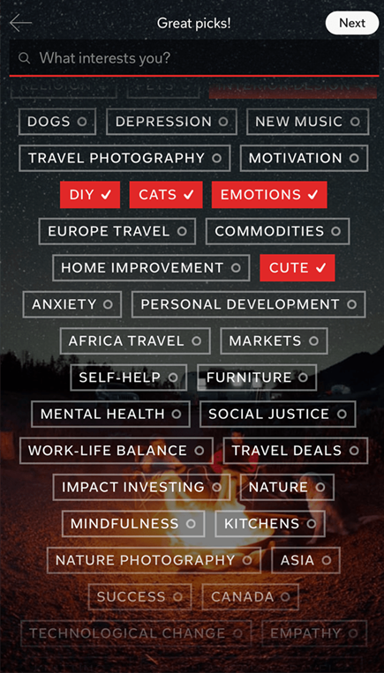
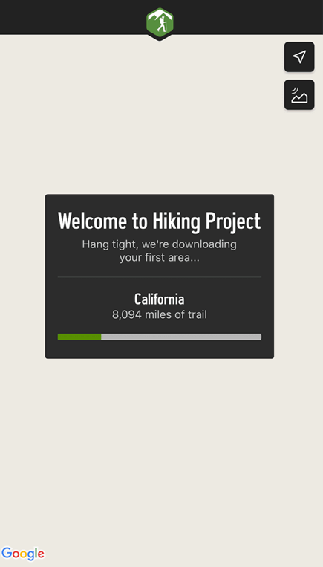
Appropriate Feedback
Whenever users interact with a system, they need to know whether the interaction was successful
Examples
Changing the color and adding a checkmark to buttons on a selection screen communicates that the system has registered the user’s choices
Progress indicators reassure the user that a longer wait is normal, and that the system is still working

Slide 11

Examples
Visual feedback for data loading

Slide 12
Compel Users to Action
Modern systems are often complex, and it is unreasonable to assume that all the variables that describe the state of a system can be communicated to the user. Yet, occasionally backstage aspects can actually play an important role frontstage.

Slide 13
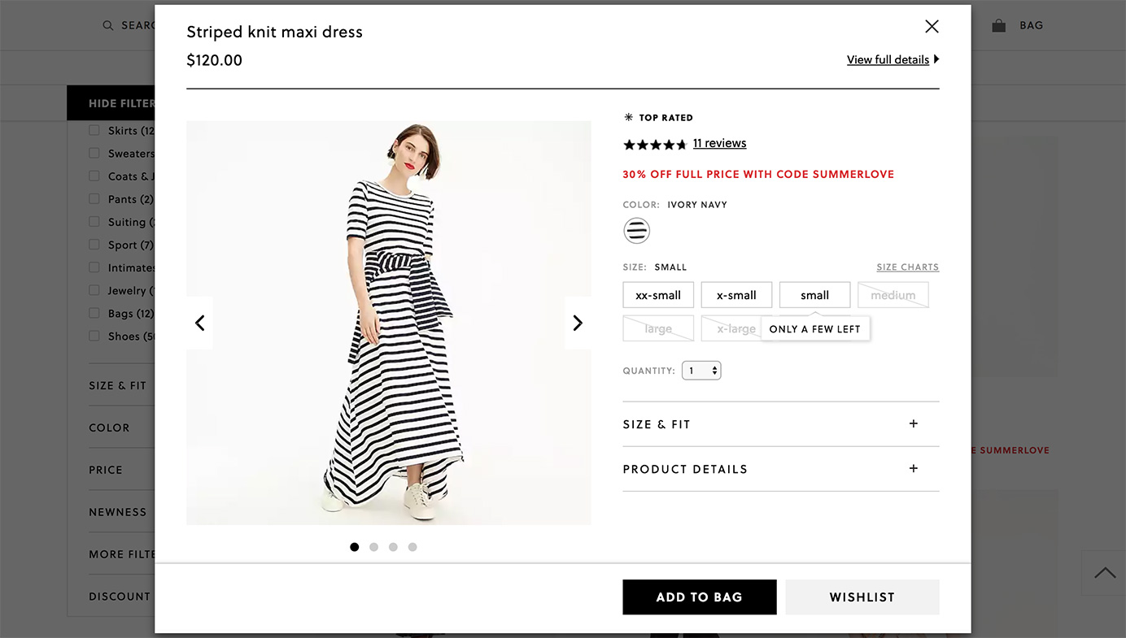
Examples
The J.Crew site displays a notification that there are “Only a Few Left!” when the user moves the mouse over low-stock sizes of a product. Some sizes are already sold out, and thus shown crossed out in light gray

Slide 14
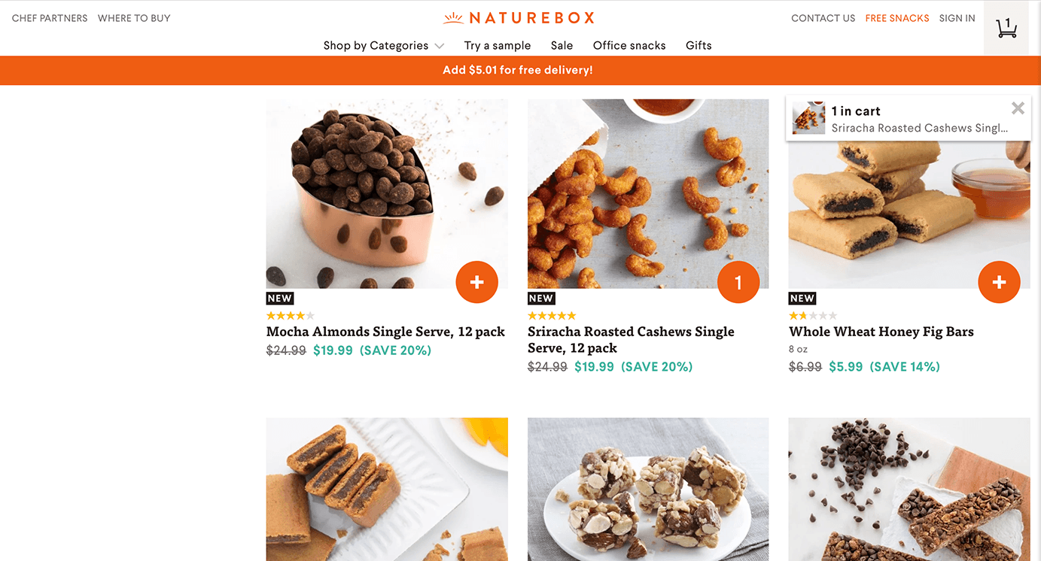
Examples
NatureBox.com: A banner across the top of the page communicates how much more money the user needs to spend to qualify for free shipping.

Slide 15
Communication Creates Trust
When we understand the system’s state, we feel in control
The predictability of the interaction creates trust in the mechanics of the app, and also in the brand itself
Sites and apps should clearly communicate to users what the system’s state is
A better way to build trust is to explicitly communicate the current system’s status

Slide 16
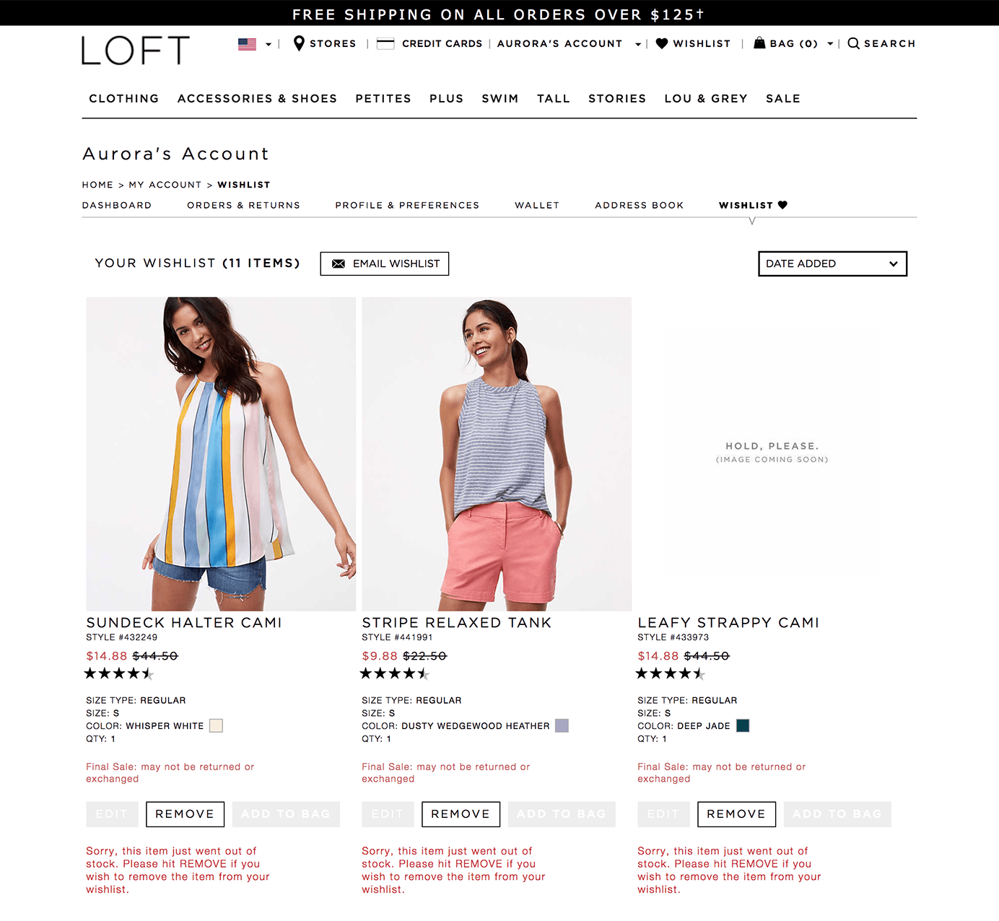
Examples
Loft.com continues to display out-of-stock items in wish lists, with appropriate messaging to communicate the status of the item to the user.

Slide 17
2. Match between system and the real world
The design should speak the users' language. Use words, phrases, and concepts familiar to the user, rather than internal jargon. Follow real-world conventions, making information appear in a natural and logical order.
Terms, concepts, icons, and images must be familiar to your users
When a design’s controls follow real-world conventions and correspond to desired outcomes (called natural mapping), it’s easier for users to learn and remember how the interface works.
Notes:
Thiết kế nên nói ngôn ngữ của người dùng. Sử dụng các từ, cụm từ và khái niệm quen thuộc với người dùng, thay vì biệt ngữ nội bộ.
Thực hiện theo các quy ước trong thế giới thực, làm cho thông tin xuất hiện theo thứ tự tự nhiên và logic.
Các thuật ngữ, khái niệm, biểu tượng và hình ảnh phải quen thuộc với người dùng của bạn
Khi các điều khiển của thiết kế tuân theo các quy ước trong thế giới thực và tương ứng với kết quả mong muốn (được gọi là ánh xạ tự nhiên), người dùng sẽ dễ dàng tìm hiểu và ghi nhớ cách giao diện hoạt động.

Slide 18
Tips
Ensure users can understand meaning without having to go look up a word’s definition.
Never assume your understanding of words or concepts will match those of your users.
User research will help you uncover your users' familiar terminology, as well as their mental models around important concepts.
Notes:
Đảm bảo người dùng có thể hiểu nghĩa mà không cần phải tra cứu định nghĩa của một từ.
Đừng bao giờ cho rằng sự hiểu biết của bạn về các từ hoặc khái niệm sẽ phù hợp với người dùng của bạn.
Nghiên cứu người dùng sẽ giúp bạn khám phá thuật ngữ quen thuộc của người dùng, cũng như các mô hình tinh thần của họ xung quanh các khái niệm quan trọng.

Slide 19

Familiar Language
BlueCross BlueShield of North Carolina provides clear answers to questions, uses familiar language, and includes references that are easy to understand.

Slide 20
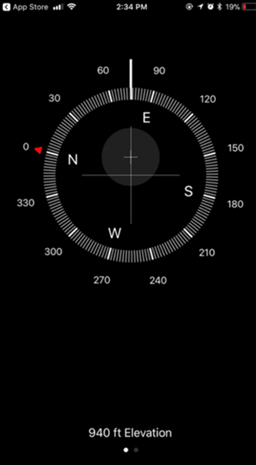

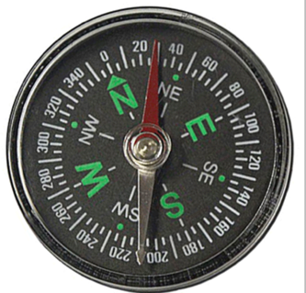

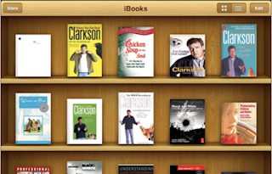
Leverage Familiarity with Real-World Objects and Activities
Using real life metaphor in application
UI elements in a compass app (left) are similar to a compass in the real-world (right)
iBooks iPad application using the metaphor of wooden book shelf

Slide 21
3. User Control and Freedom
Users often choose system functions by mistake and will need a clearly marked "emergency exit" to leave the unwanted state without having to go through an extended dialogue.
Tips
Support Undo and Redo.
Show a clear way to exit the current interaction, like a Cancel button.
Make sure the exit is clearly labeled and discoverable.
Notes:
Vietnamese translation. Người dùng thường chọn nhầm các chức năng hệ thống và sẽ cần một "lối thoát khẩn cấp" được đánh dấu rõ ràng để rời khỏi trạng thái không mong muốn mà không phải trải qua một cuộc đối thoại mở rộng.
Hỗ trợ hoàn tác và làm lại.

Slide 22
Go back to the previous state
There are several UI controls that allow people to go back to the previous state of the system:
A Back link which returns users to a previous page or screen
A Cancel link which allows the user to quit a task or multi-step process
A Close link which allows users to close a new view
An Undo option (and a corresponding redo option) to allow users to backtrack on a change to a UI element

Slide 23
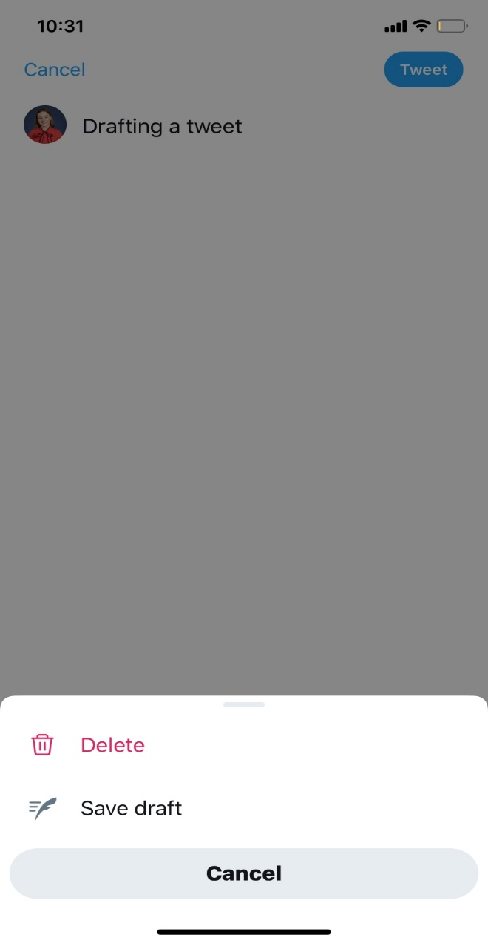
Allow Users to Easily Cancel an Action
When users begin to compose a tweet, they can easily cancel the task by selecting Cancel at the top left of the screen.
Upon doing so, Twitter presents the user with the option to delete the message or save a draft

Slide 24
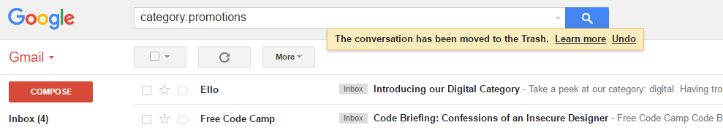
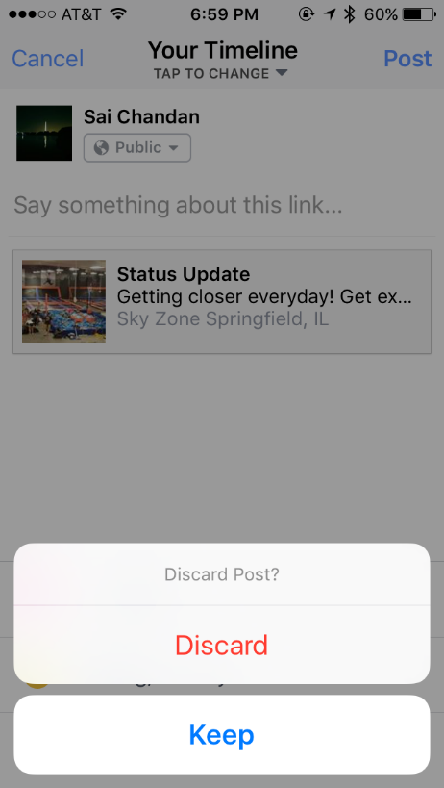
Support Undo Examples
Gmail’s flash message with undo action when we accidentally delete an email
Facebook checking on me if I tapped “Cancel” by mistake

Slide 25
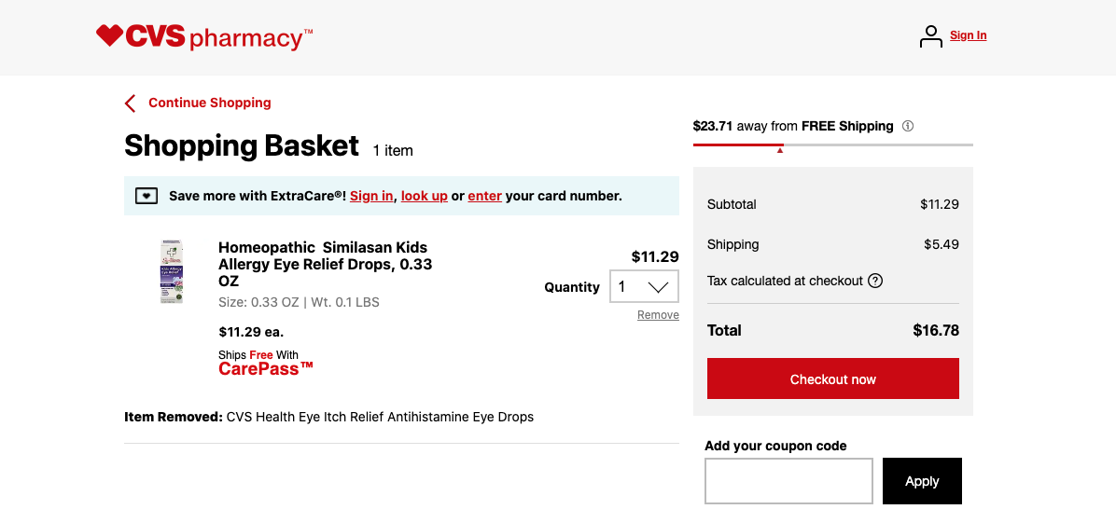
Support Undo Examples
On an ecommerce site, a user can undo adding an item to the basket, by selecting Remove

Slide 26
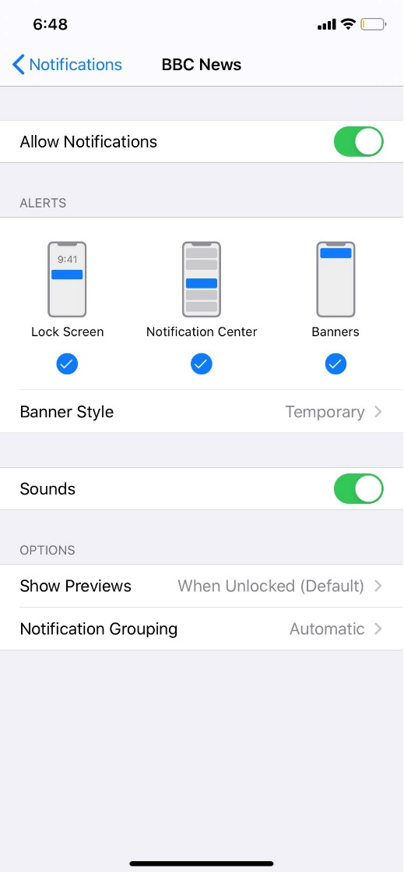
Support Undo Examples
When changing notification settings, a user can undo a change by using the toggles and checkboxes.

Slide 27
4. Consistency and Standards
Users should not have to wonder whether different words, situations, or actions mean the same thing. Follow platform conventions.
Tips
Improve learnability by maintaining both types of consistency: internal and external.
Maintain consistency within a single product or a family of products (internal consistency).
Follow established industry conventions (external consistency).
Notes:
Người dùng không cần phải tự hỏi liệu các từ ngữ, tình huống hoặc hành động khác nhau có nghĩa giống nhau hay không. Thực hiện theo các quy ước nền tảng. Mẹo
Cải thiện khả năng học hỏi bằng cách duy trì cả hai loại tính nhất quán: nội bộ và bên ngoài.
Duy trì tính nhất quán trong một sản phẩm duy nhất hoặc một dòng sản phẩm (tính nhất quán bên trong).
Thực hiện theo các quy ước ngành đã được thiết lập (tính nhất quán bên ngoài).

Slide 28
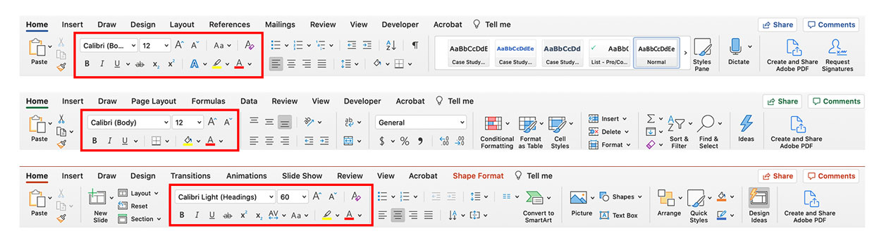
Internal Consistency
Most application suites will list menu components in the same order (File, Edit, View, and so on) or will use consistent icons for the same functions across applications and familiar layouts for dialog boxes and modals
The many layers of consistency within Microsoft Office

Slide 29
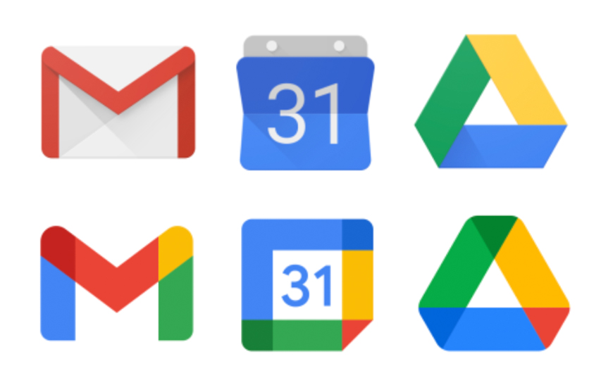
Examples
Google’s previous version of the Mail, Calendar, and Drive icons (top) had a consistent visual style

Slide 30
5. Error Prevention
Good error messages are important, but the best designs carefully prevent problems from occurring in the first place. Either eliminate error-prone conditions, or check for them and present users with a confirmation option before they commit to the action.

Slide 31
Error Prevention Tips
Prioritize your effort: Prevent high-cost errors first, then little frustrations.
Avoid slips by providing helpful constraints and good defaults.
Prevent mistakes by removing memory burdens, supporting undo, and warning your users.

Slide 32
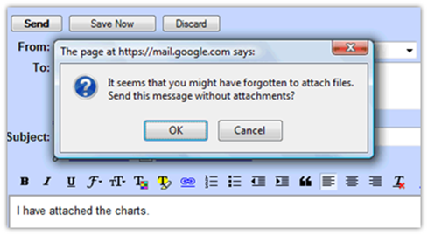
Examples

Slide 33
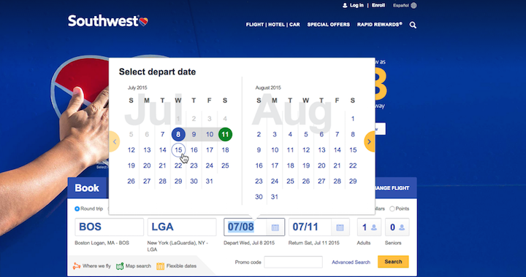
Include Helpful Constraints Example
Southwest’s calendar widget for picking flight dates uses helpful constraints to prevent users from accidentally setting a nonsensical date range

Slide 34
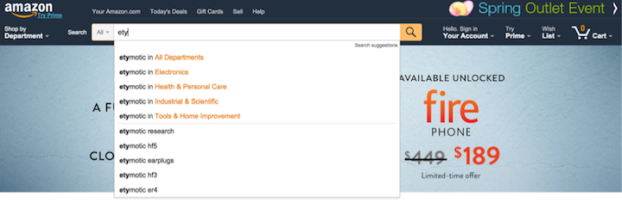
Offer Suggestions Example
Amazon’s clickable search suggestions enable users to type less

Slide 35
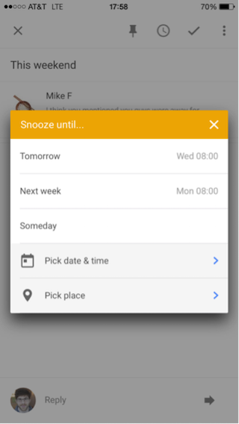
Choose Good Defaults Example
Google’s Inbox app for iOS allows you to “snooze” an email until a later time. The default options are sensible and prevent typing errors for common choices.

Slide 36
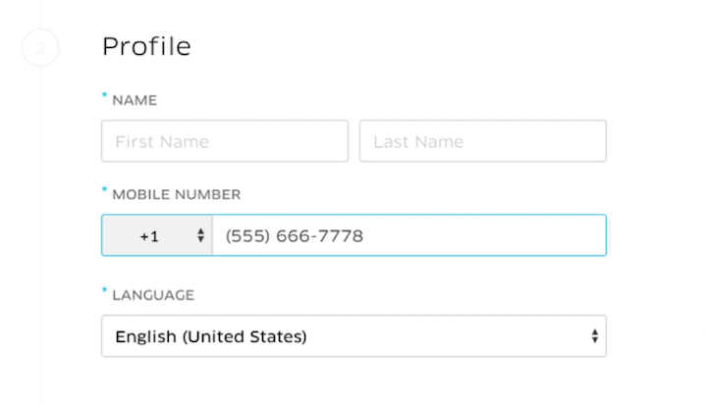
Use Forgiving Formatting Example
Uber.com automatically displays the phone number in the desired format as users type, so that they can more easily scan their work to confirm that it’s correct.

Slide 37
6. Recognition rather than recall
Minimize the user's memory load by making elements, actions, and options visible. The user should not have to remember information from one part of the interface to another. Information required to use the design (e.g. field labels or menu items) should be visible or easily retrievable when needed.

Slide 38
Tips
Let people recognize information in the interface, rather than forcing them to remember (“recall”) it.
Offer help in context, instead of giving users a long tutorial to memorize.
Reduce the information that users have to remember.

Slide 39
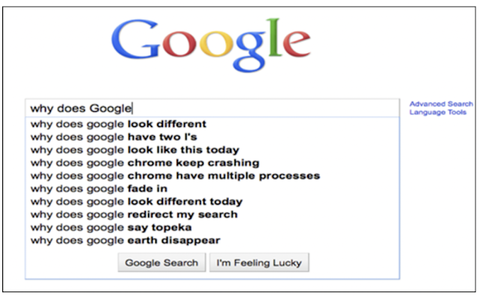
Example

Slide 40
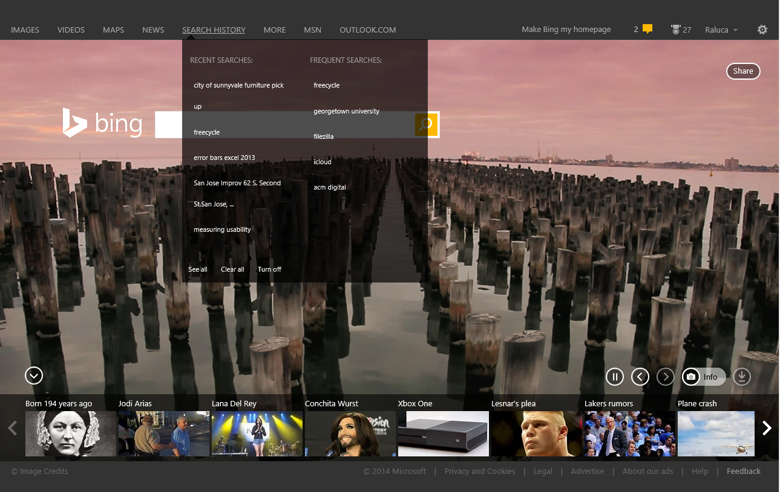
History and Previously Visited Content Example
Bing has a link to the user’s search history. The link helps users remember previous searches.

Slide 41
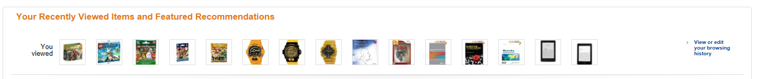
History and Previously Visited Content Example
When a user goes back to Amazon.com, the personalized homepage includes a list of recently viewed items.

Slide 42
7: Flexibility and efficiency of use
Shortcuts — hidden from novice users — may speed up the interaction for the expert user so that the design can cater to both inexperienced and experienced users. Allow users to tailor frequent actions.

Slide 43
Tips
Provide accelerators like keyboard shortcuts and touch gestures.
Provide personalization by tailoring content and functionality for individual users.
Allow for customization, so users can make selections about how they want the product to work.

Slide 44
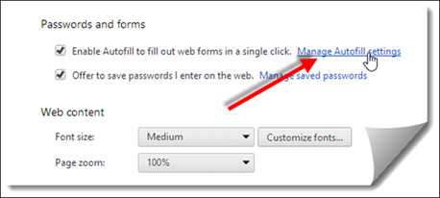
Enable Autofill Example

Slide 45
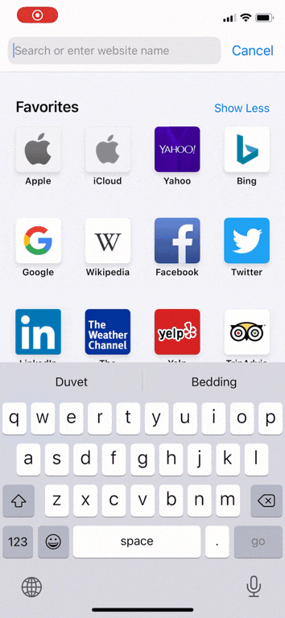
Accelerators Improve Repetitious Usage Example
The iOS keyboard allows swiping through the letters of a word instead of tapping them individually. This gesture is an accelerator: it helps experienced users but does not make typing harder to learn for novices.

Slide 46
8: Aesthetic and minimalist design
Interfaces should not contain information that is irrelevant or rarely needed. Every extra unit of information in an interface competes with the relevant units of information and diminishes their relative visibility.

Slide 47
Tips
Keep the content and visual design of UI focused on the essentials.
Don't let unnecessary elements distract users from the information they really need.
Prioritize the content and features to support primary goals.

Slide 48
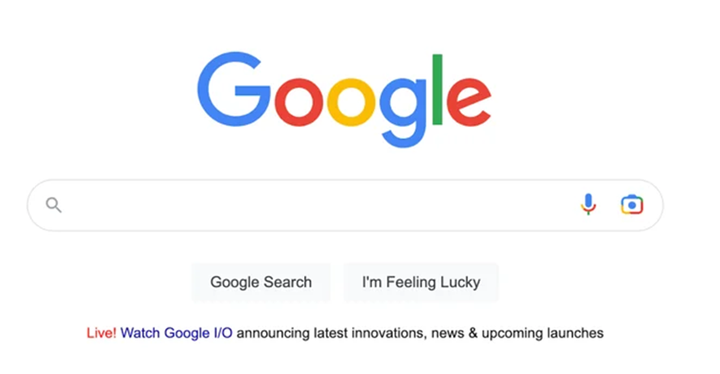
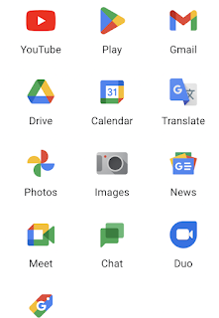
Example

Slide 49
9: Help users recognize, diagnose, and recover from errors
Error messages should be expressed in plain language (no error codes), precisely indicate the problem, and constructively suggest a solution.
Tips
Use traditional error-message visuals, like bold, red text.
Tell users what went wrong in language they will understand — avoid technical jargon.
Offer users a solution, like a shortcut that can solve the error immediately.

Slide 50
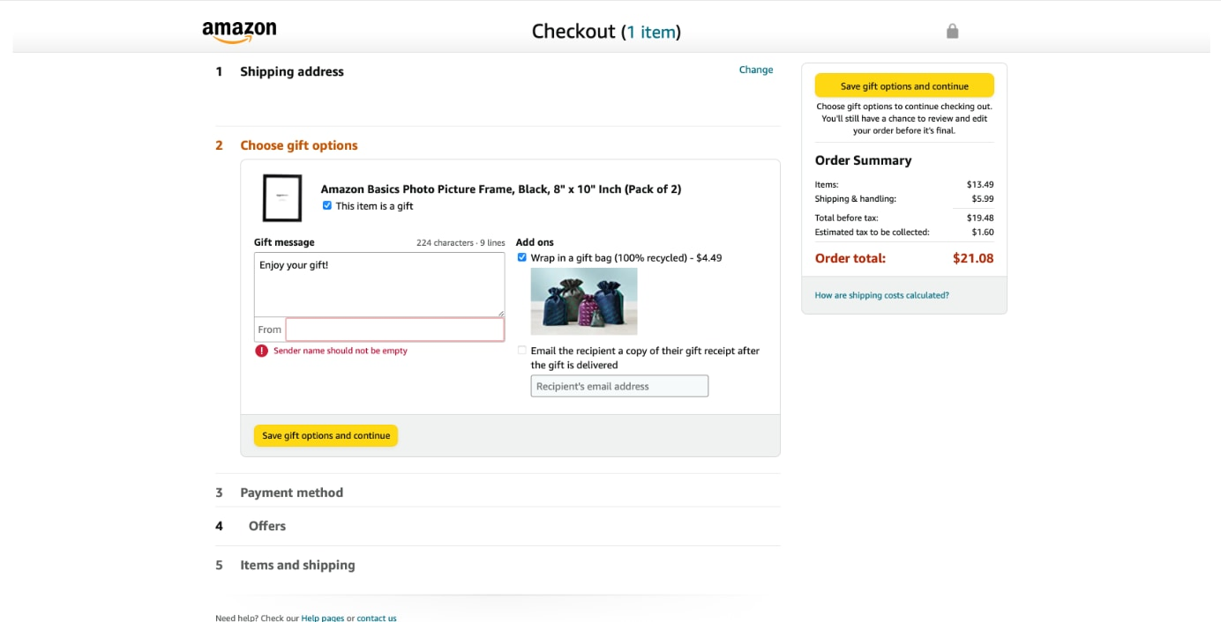
Visibility Guidelines Example
Amazon utilizes several techniques to indicate an error: border highlighting, iconography, and red text.

Slide 51
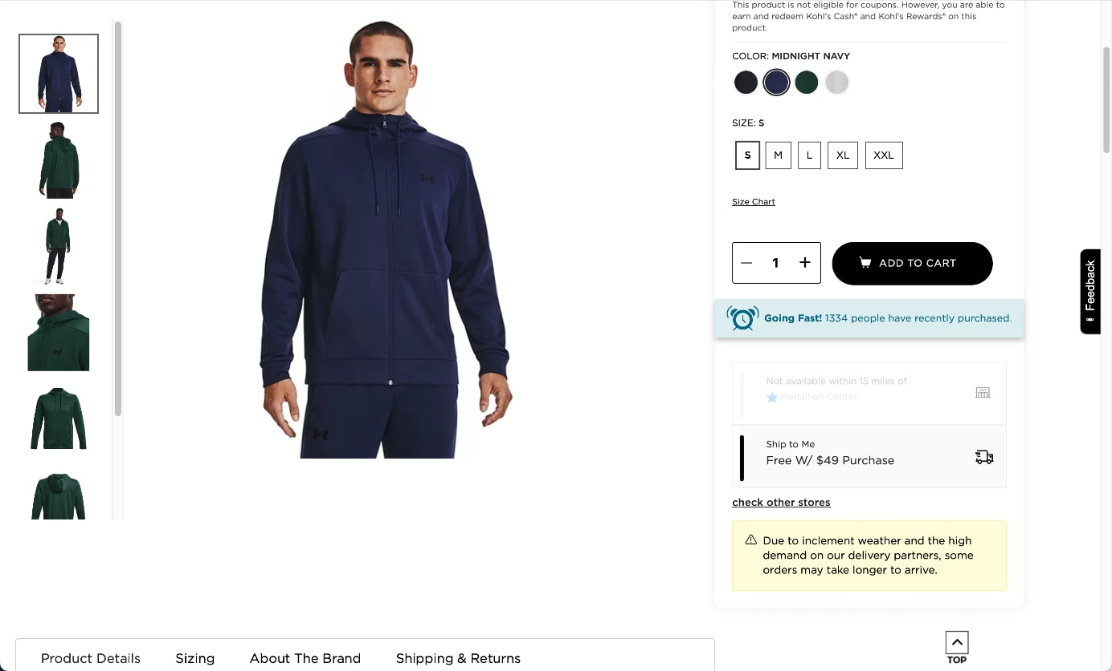
Example
Kohl’s uses a message without conventional red formatting to notify users about potential shipping delays.

Slide 52
10: Help and documentation
It’s best if the system doesn’t need any additional explanation. However, it may be necessary to provide documentation to help users understand how to complete their tasks.
Tips
Ensure that the help documentation is easy to search.
Whenever possible, present the documentation in context right at the moment that the user requires it.
List concrete steps to be carried out.

Slide 53
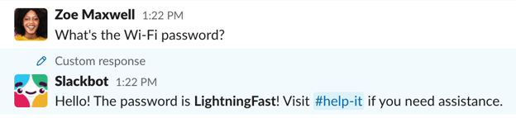
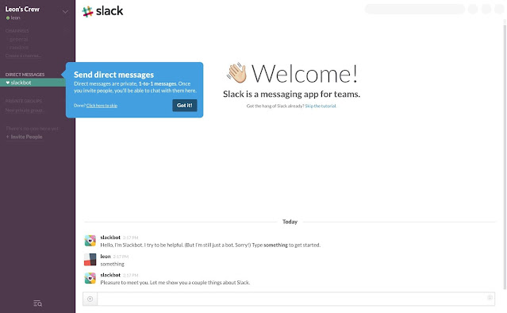
Example
Context Help

Slide 54
Eight Golden Rules of Interface Design by Shneiderman & Plaisant, 2005
1. Strive for consistency
2. Enable frequent users to use shortcuts
3. Offer informative feedback
4. Design dialog to yield closure
5. Offer simple error handling
6. Permit easy reversal of actions
7. Support internal locus of control
8. Reduce short-term memory load

